Slide 1

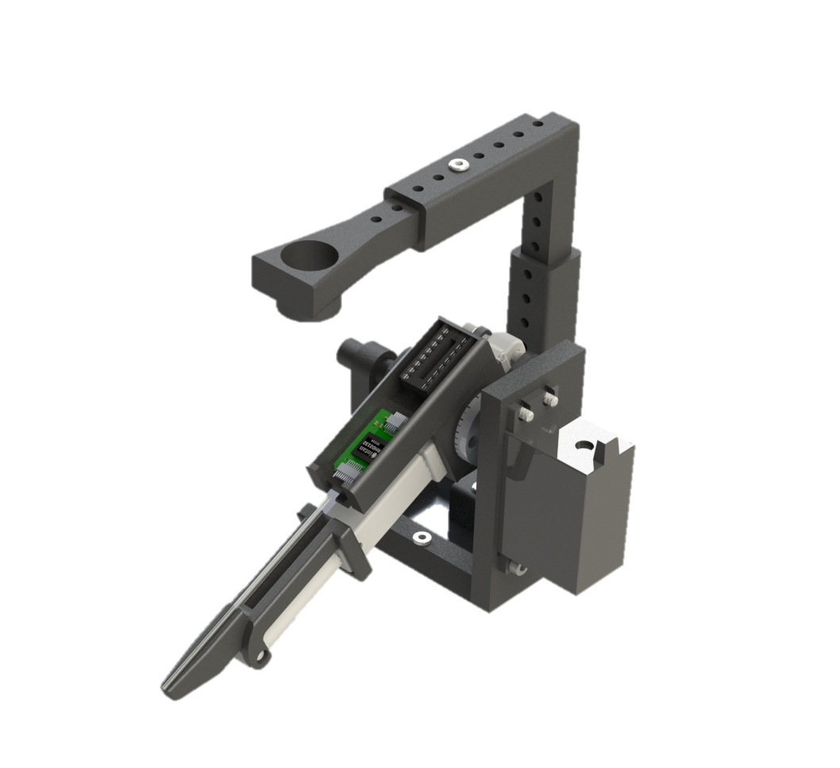
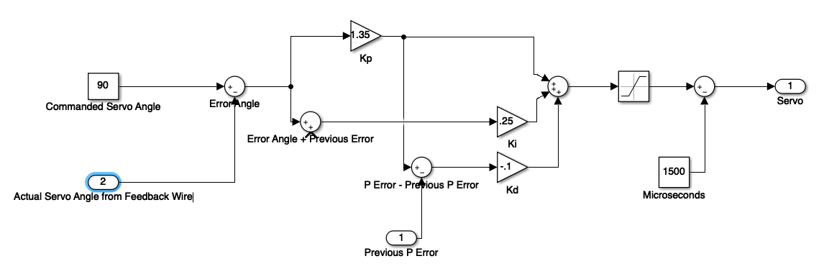
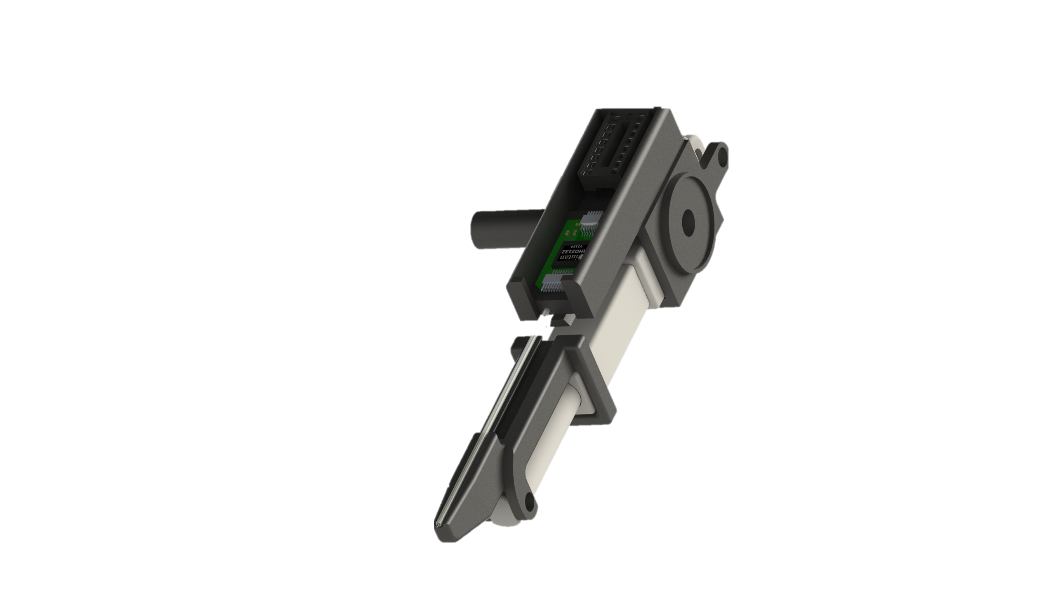
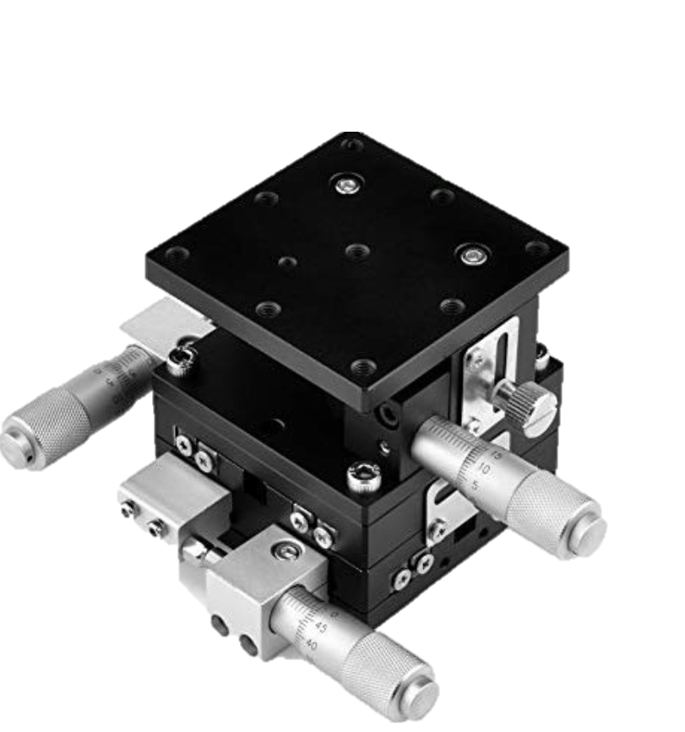
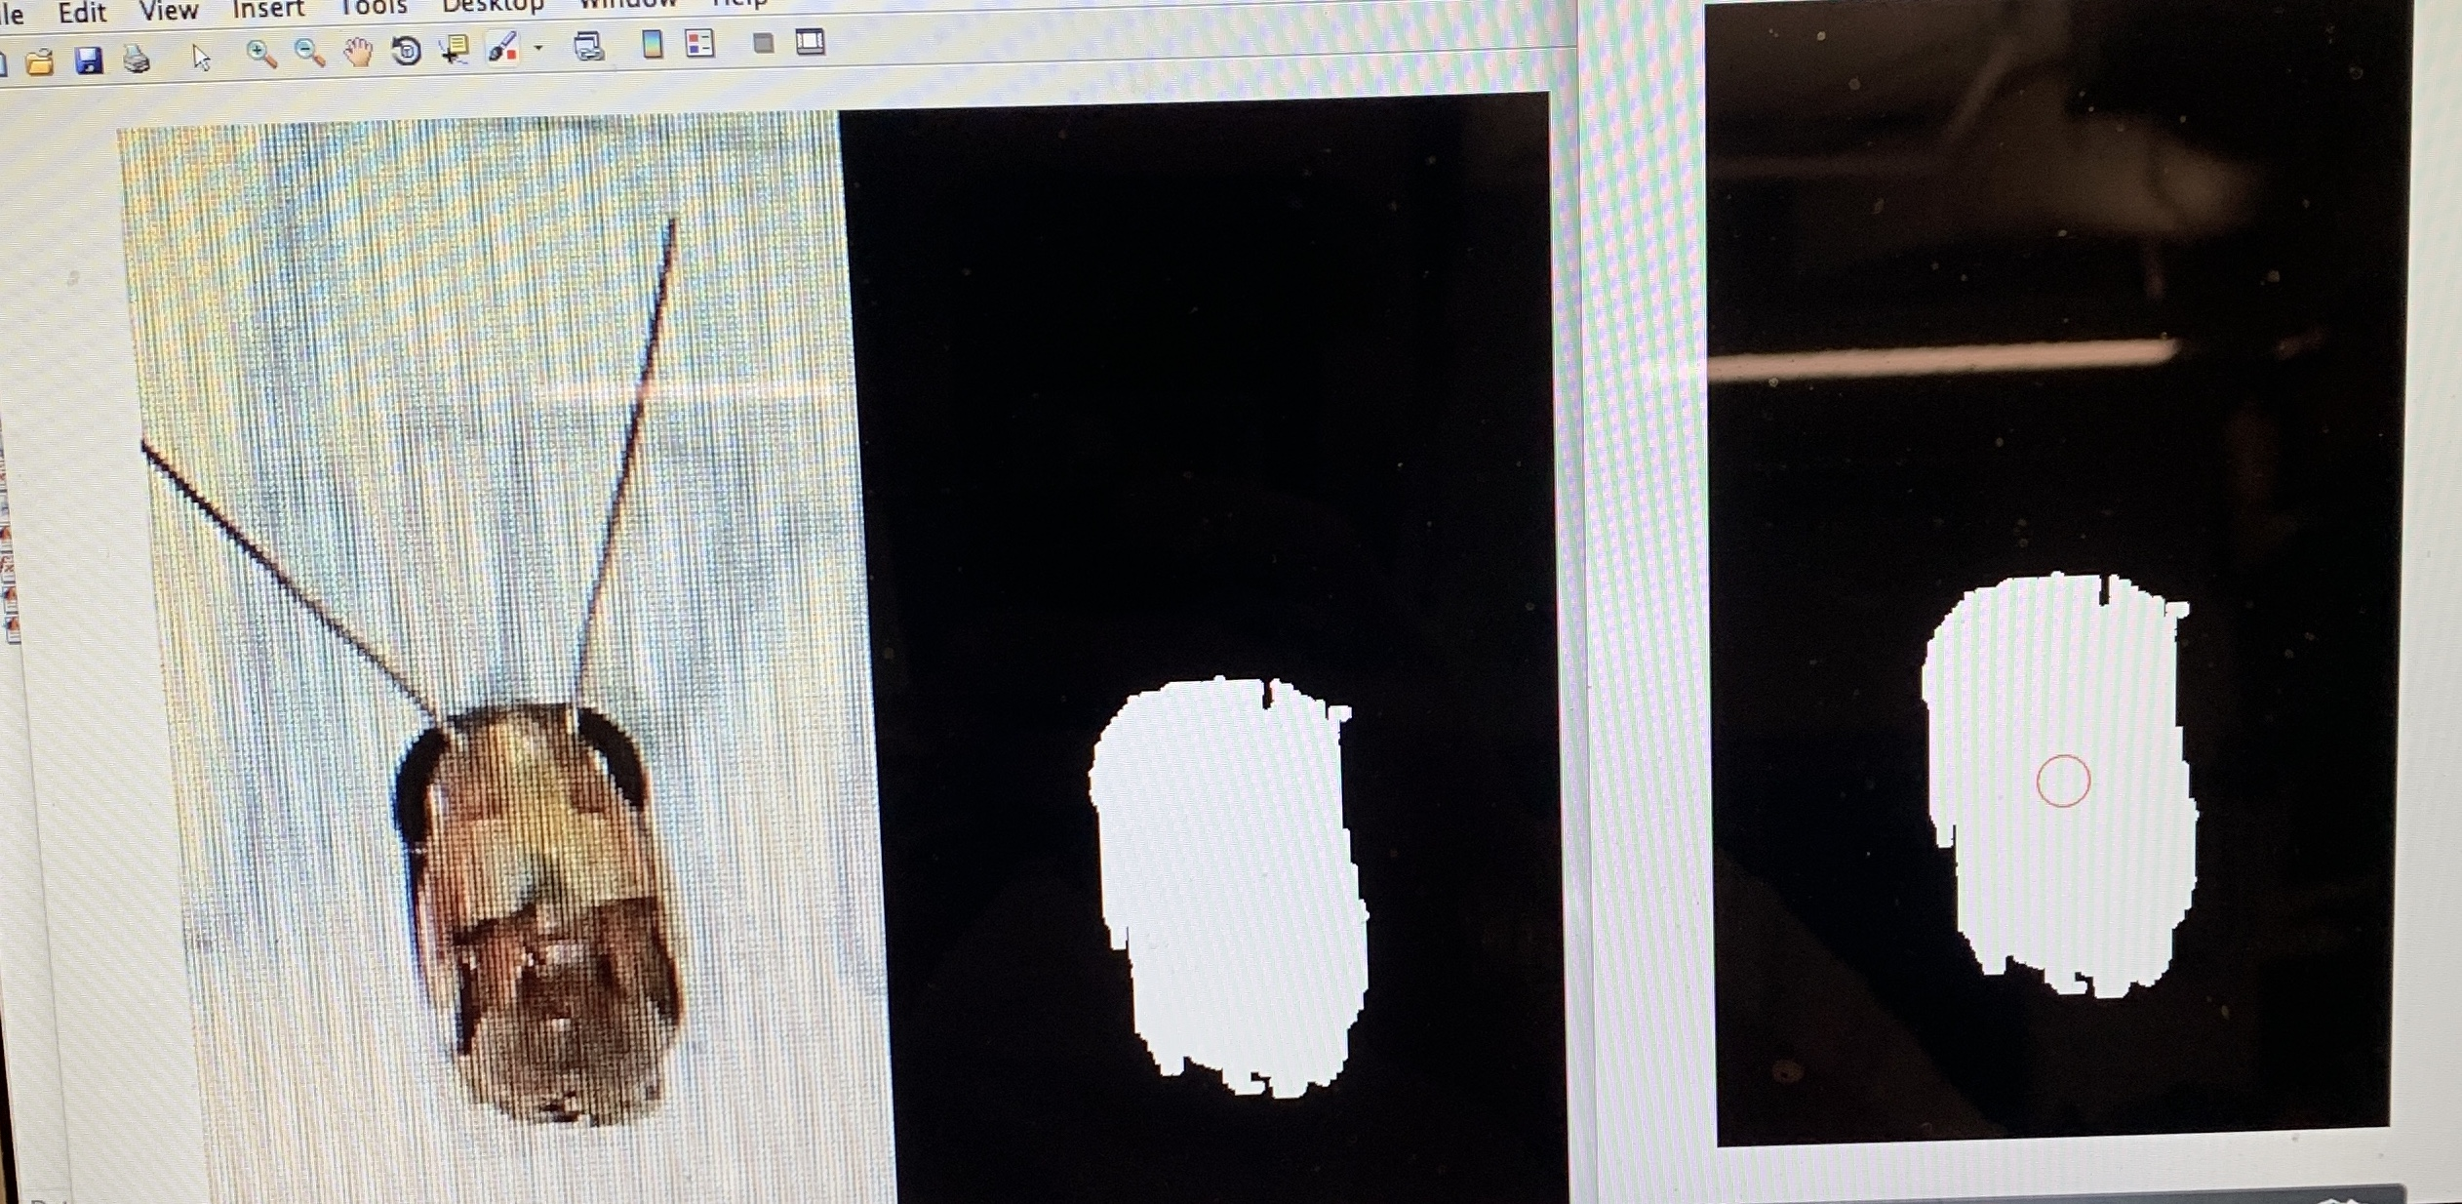
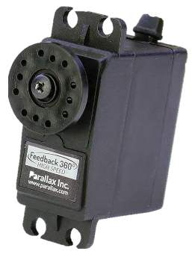
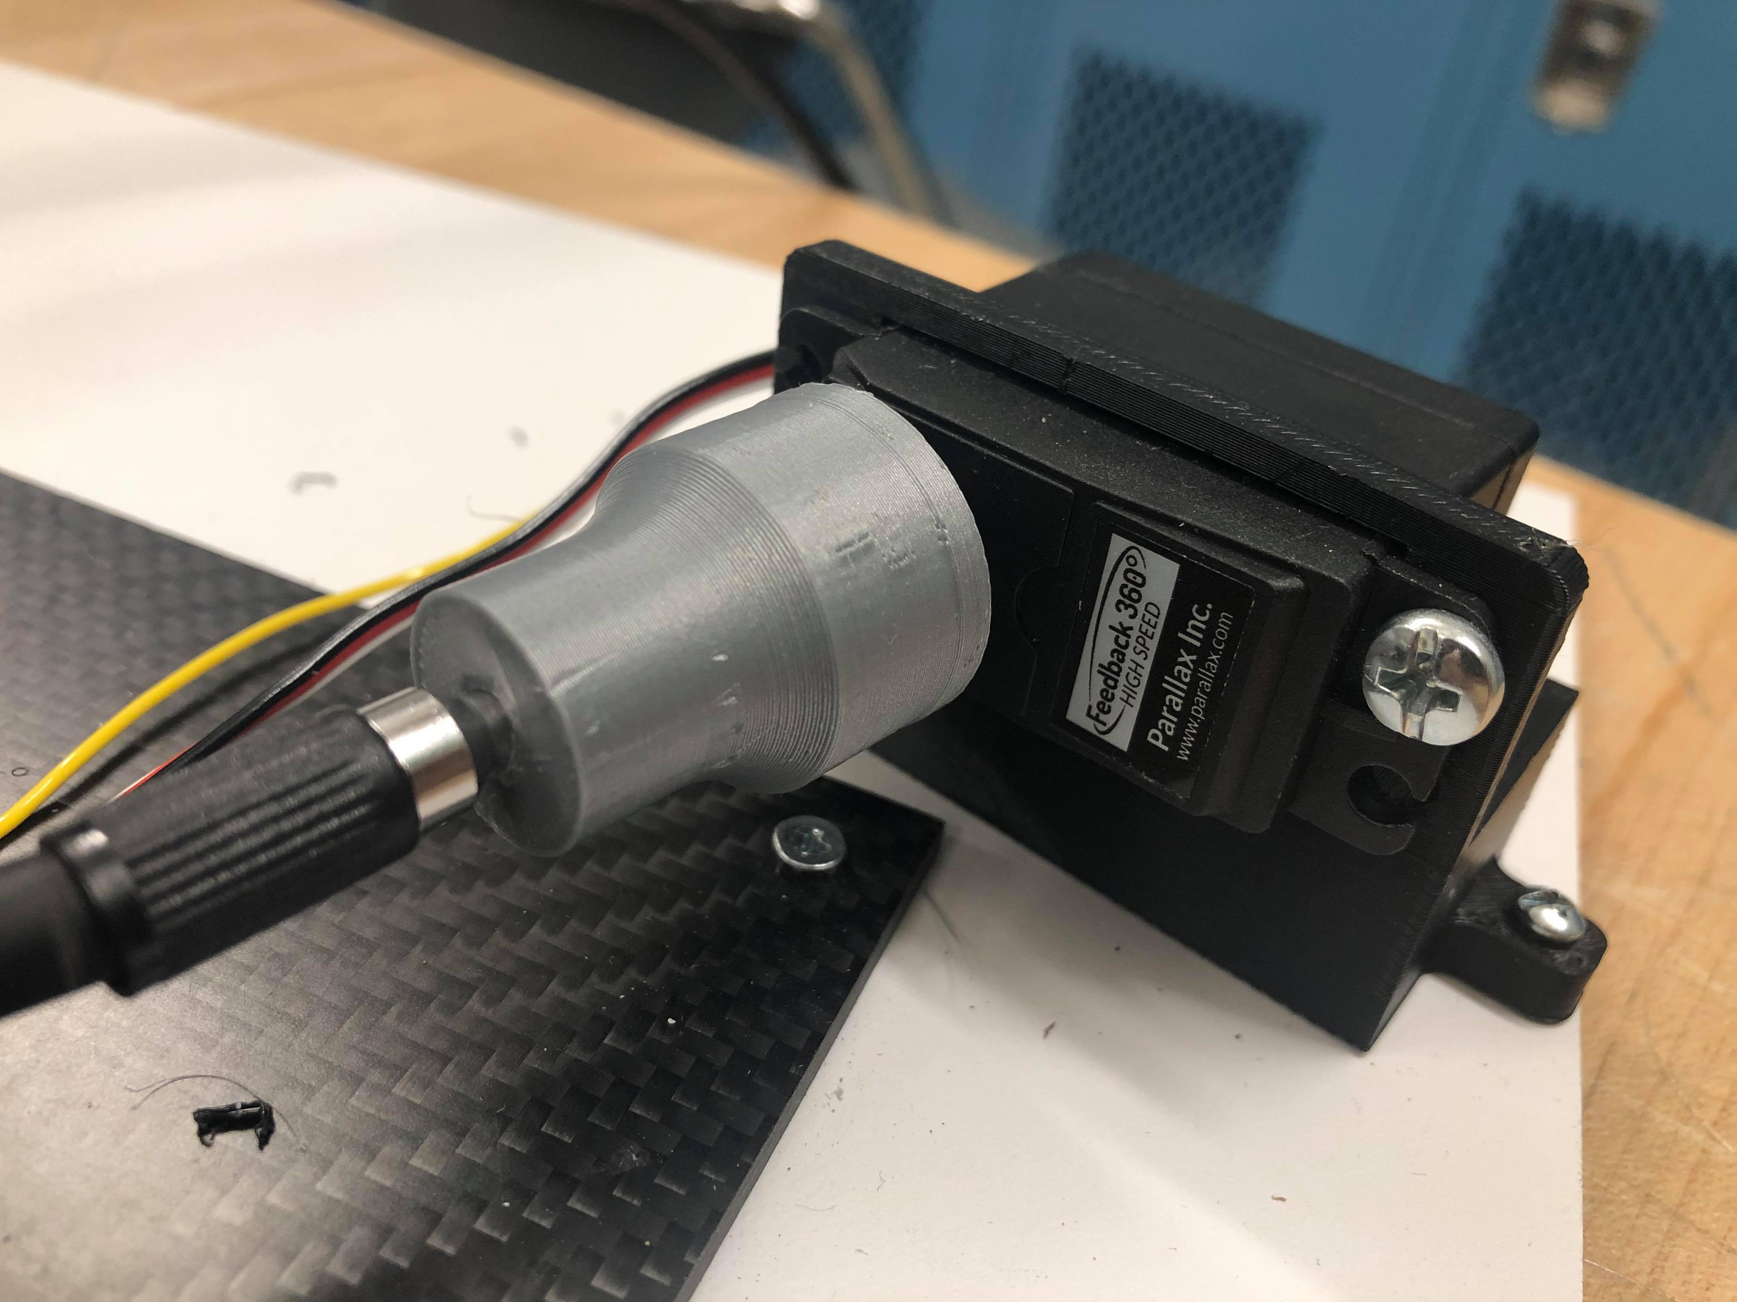
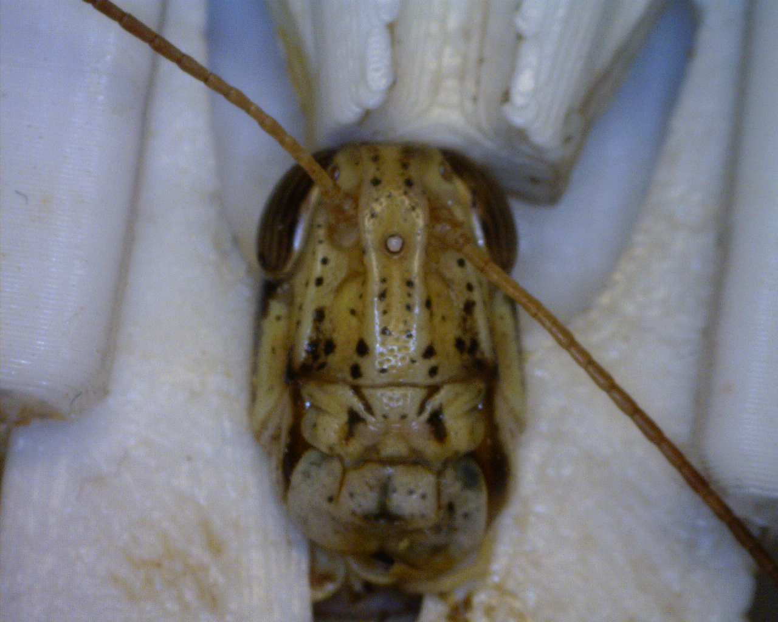
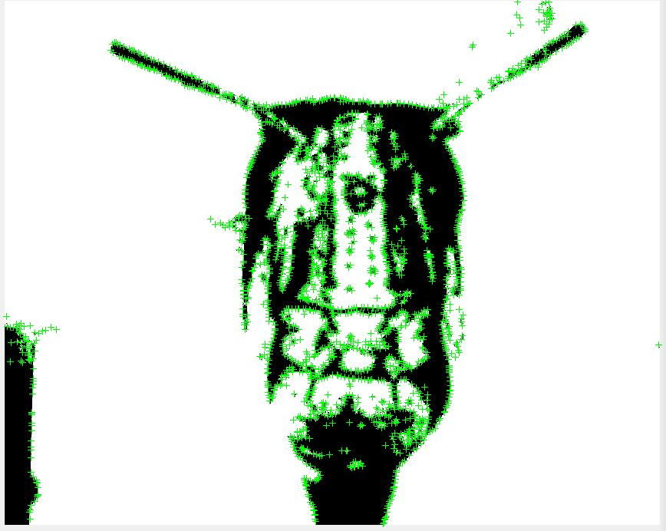
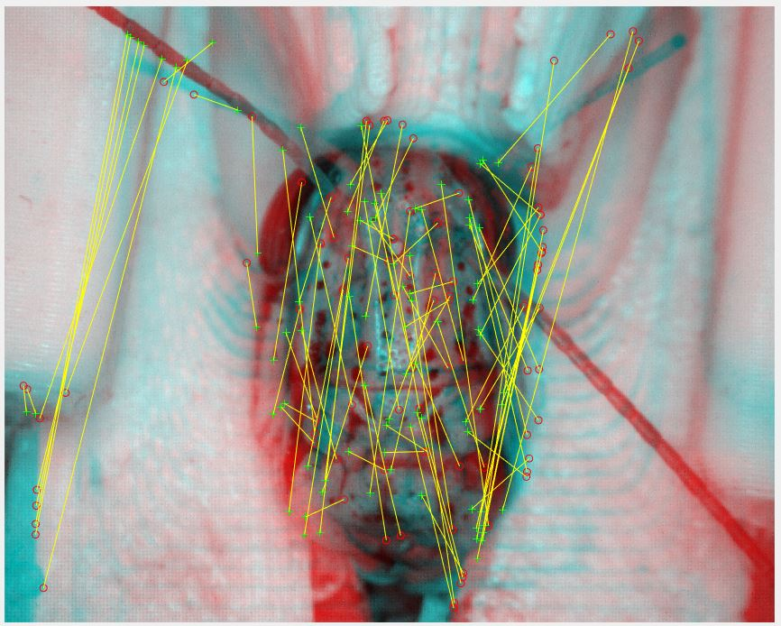
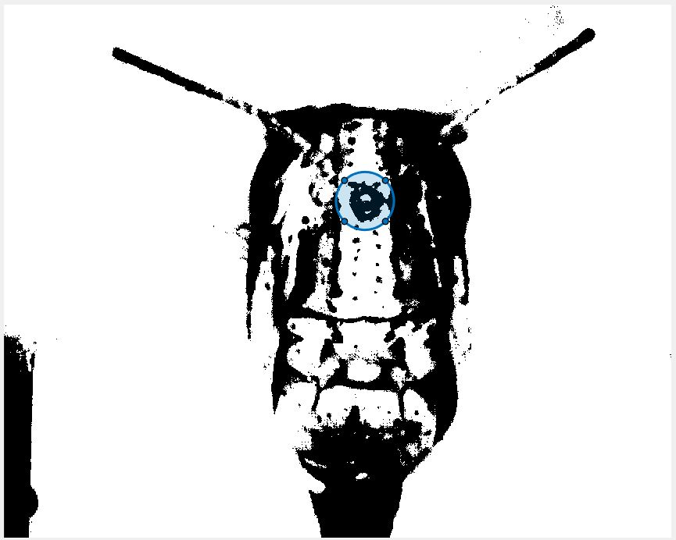
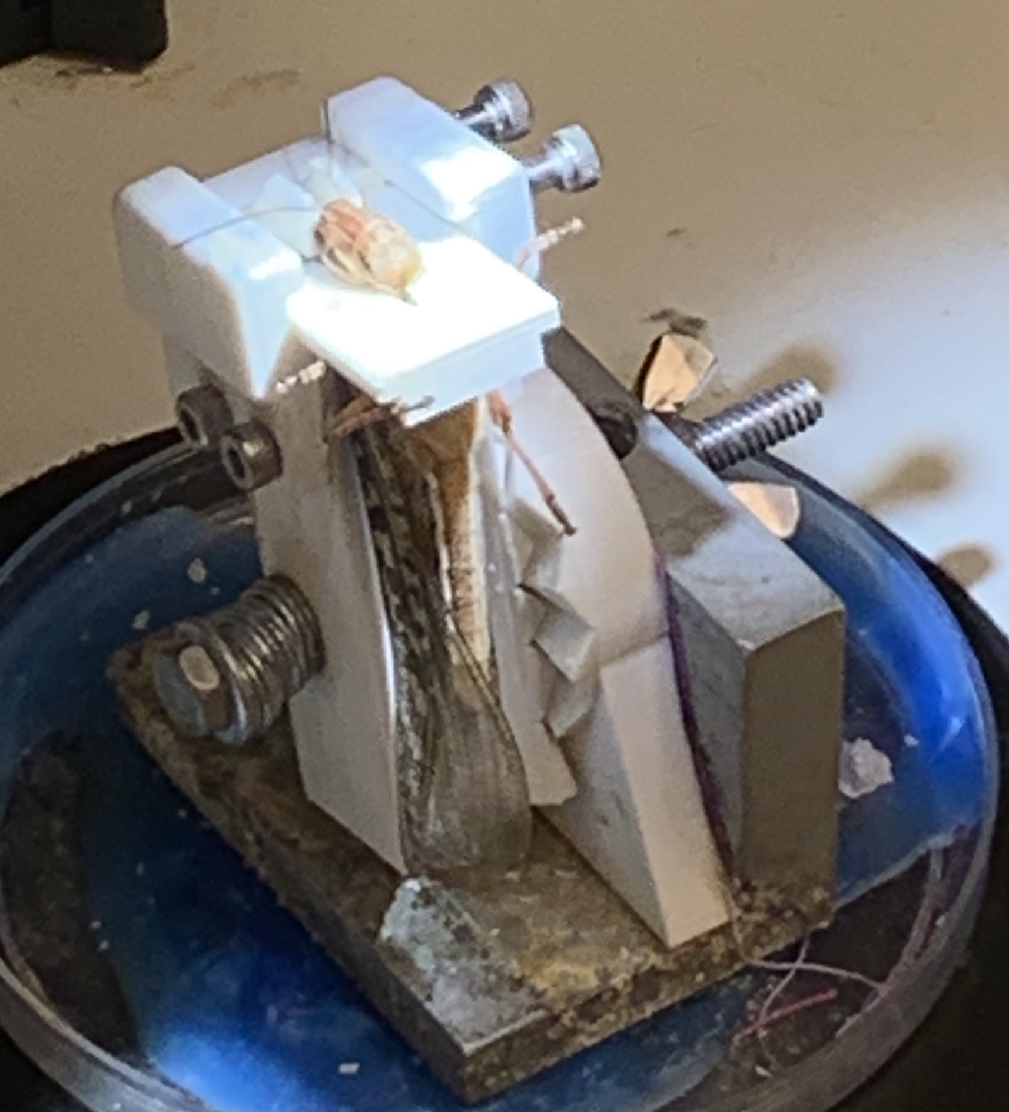
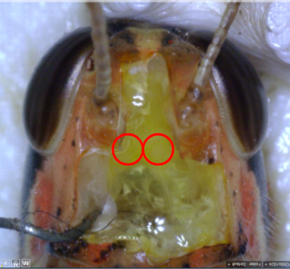
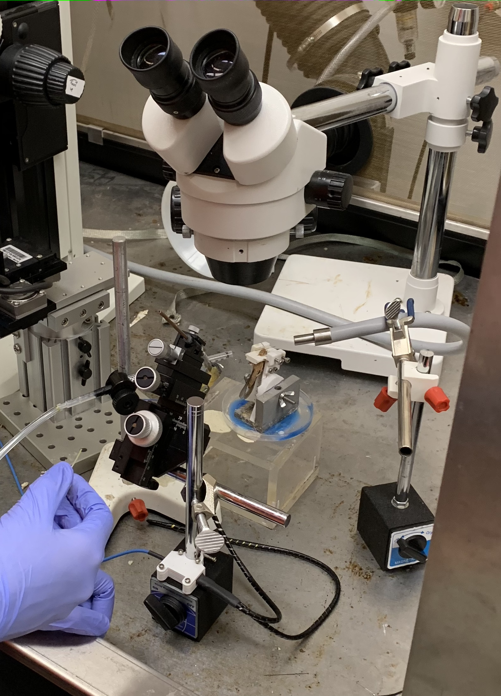
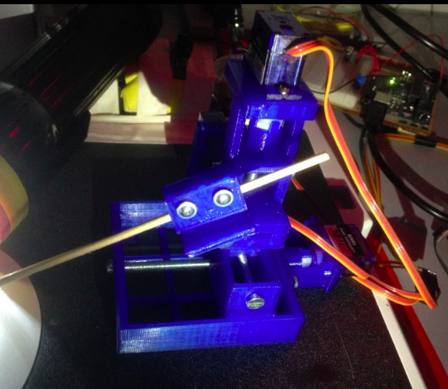
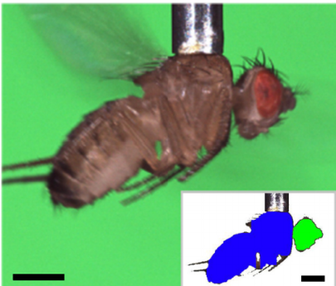
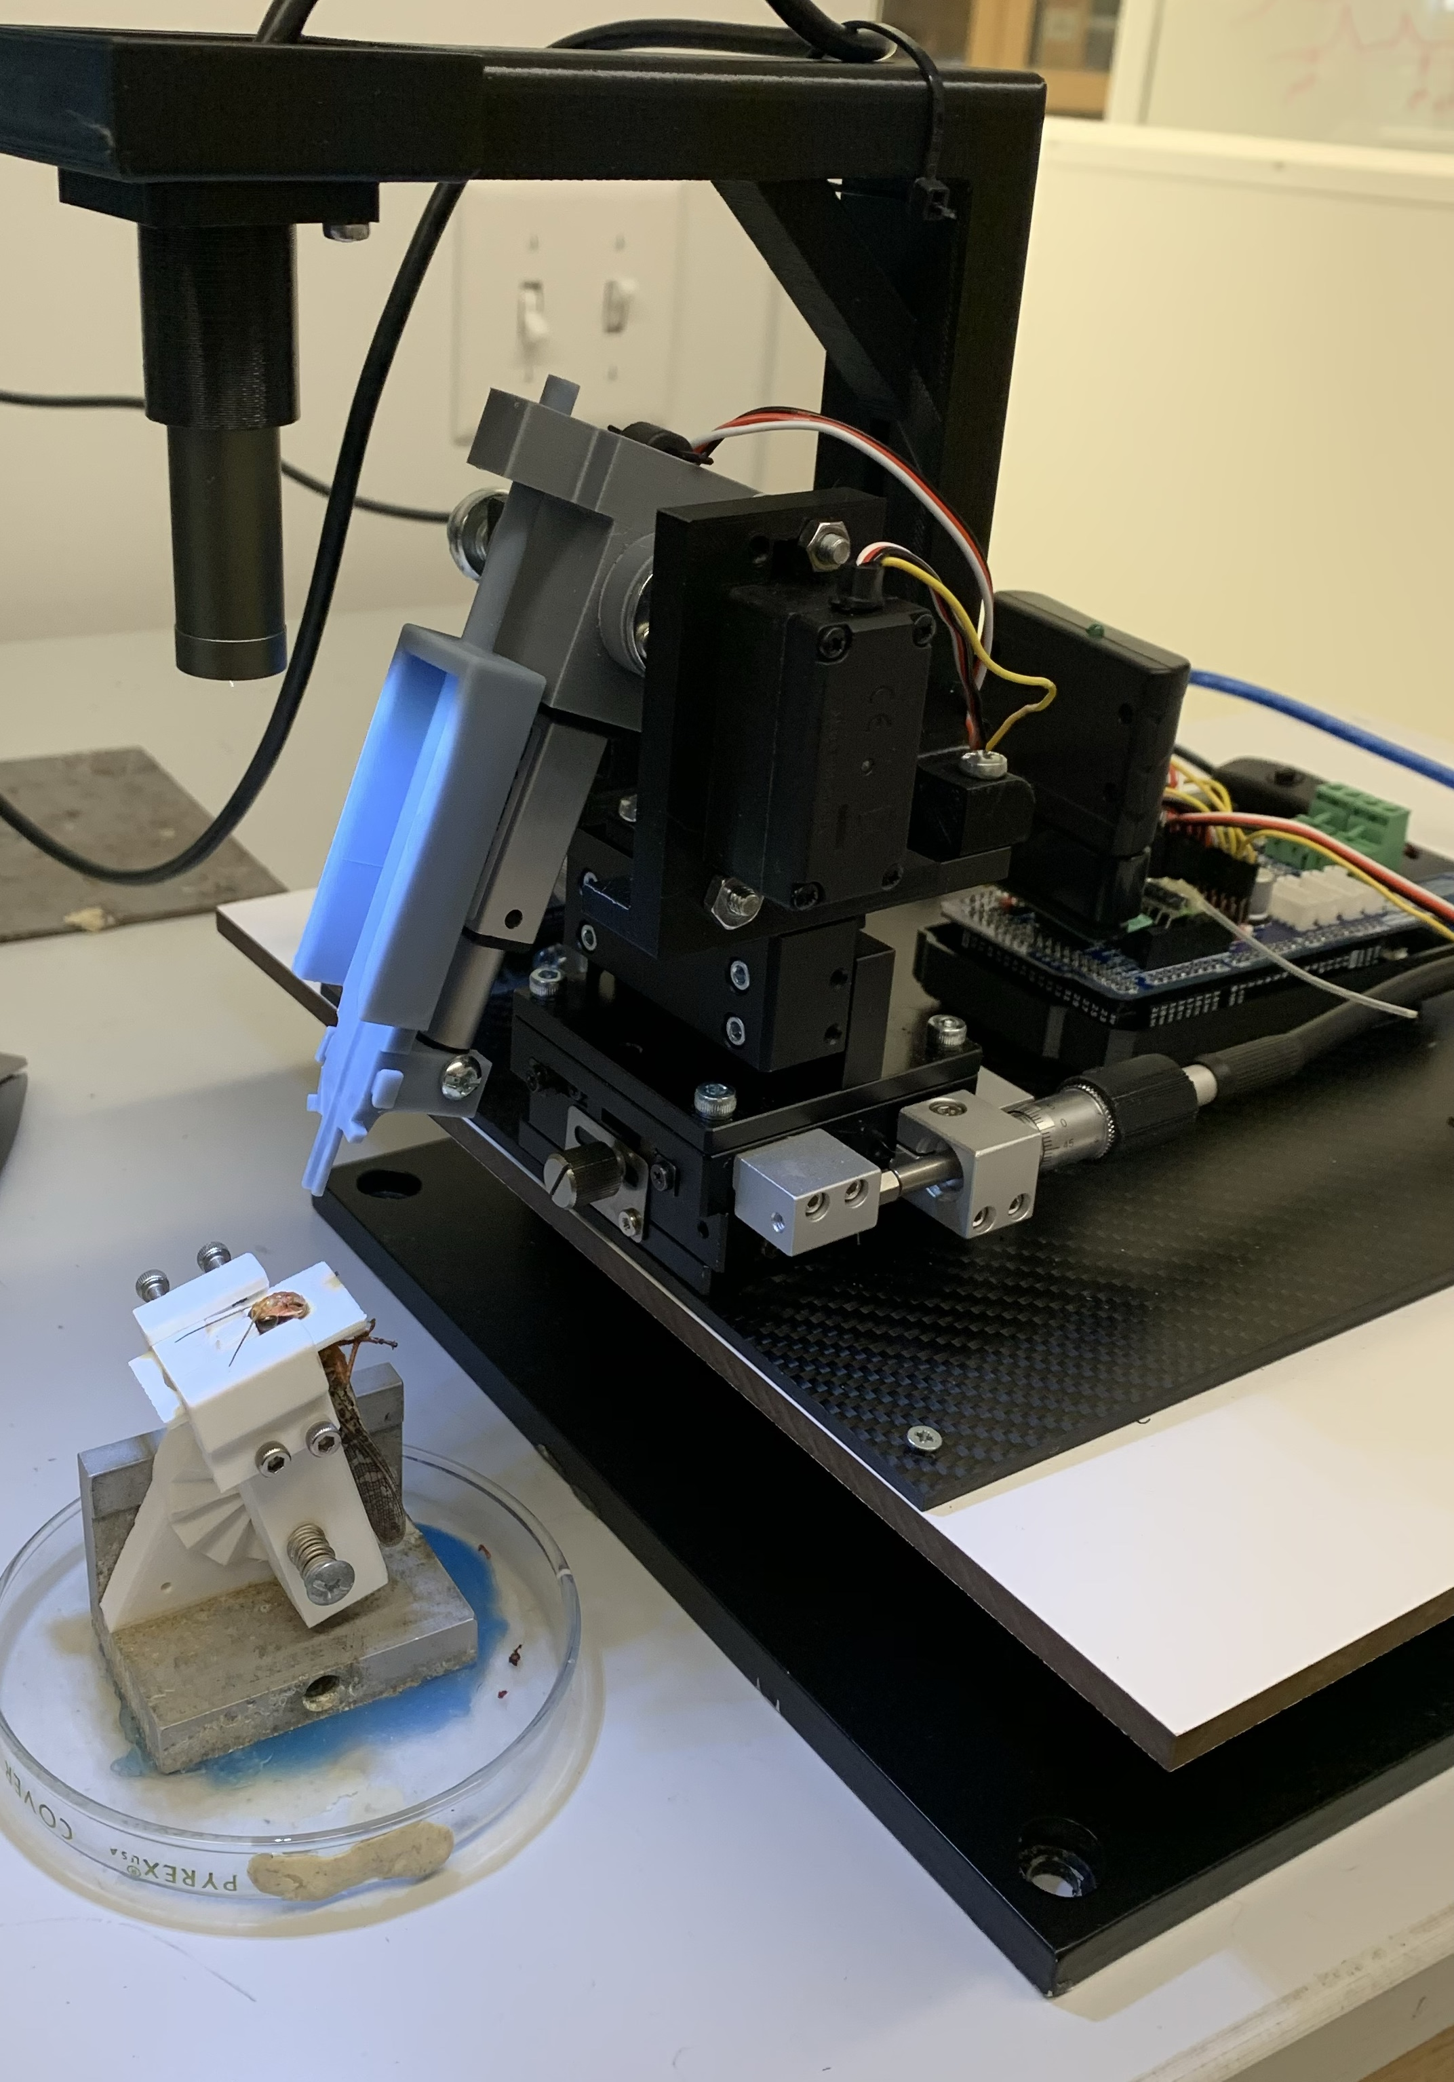
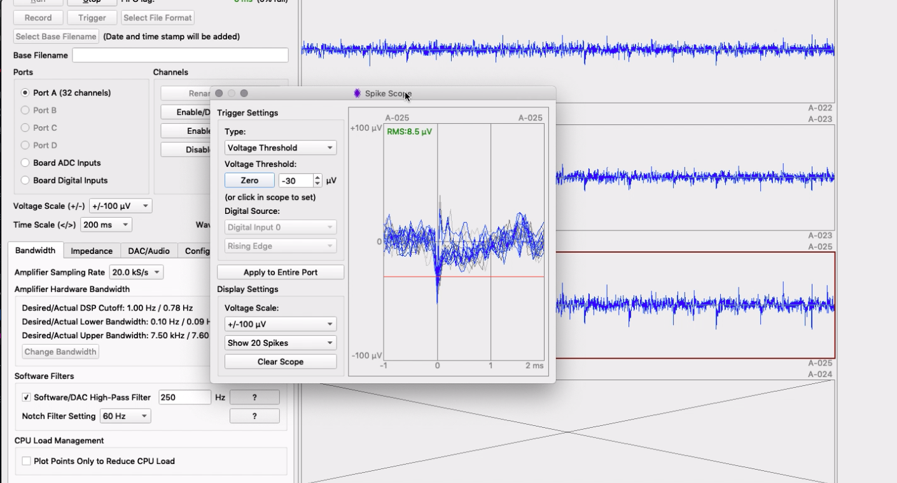
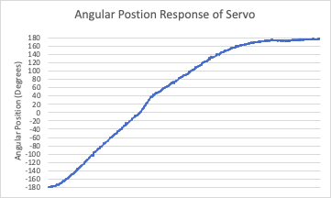
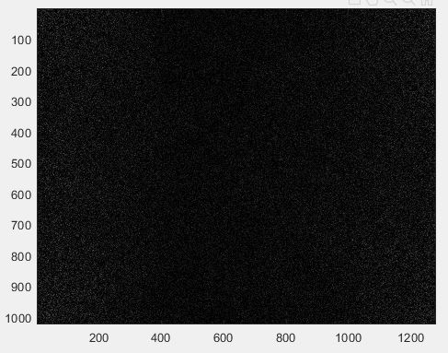
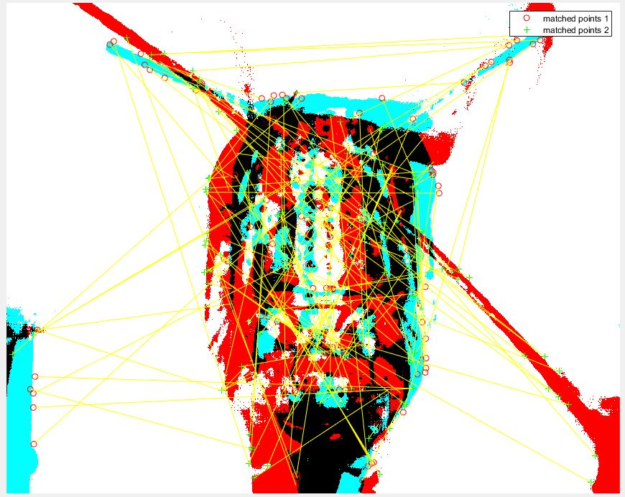
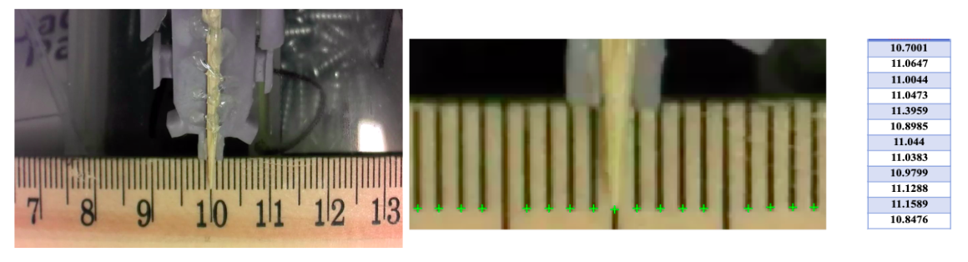
University logo
Automated Robotic Surgery for Cyborg Locusts
Anton Salem¹, Runkun Wang¹, Shantanu Chakrabartty^{1,2}
Washington University in St. Louis¹, Adaptive Integrated Microsystems Laboratory²
Introduction
Methods
Conclusions
gt
The motivation for this project comes from a team of engineers at Washington University in St. Louis in the Adaptive working to develop cyborg insects as bio-robotic sensing machines.
Odors prompt dynamic neural activity in the locust’s brain that allow the locust to correctly identify a particular odor in the presence of many.
It is advantageous to auto the surgical procedure to produce cyborg locus at scale.
Manipulator Hardware Development
Electromechanical Control
Robotic Manipulator Design
Closed Loop Control
An automated robotic manipulator is an effective method for the accurate surgical procedure of cyborg locusts.
The developed micromanipulator could be accurately controlled through a closed loop control system.
Image processing can be used to used to identify, characterize, and track the locust’s head.
-A simple PID controller is used to command the servo’s rotational angle (above) with the servo’s angular feedback signal.
Image Processing
- XYZ Linear Stage (Left), Full Robotic Manipulator Render (Middle), and electrode inserter (Right).
Future Work
The robotic manipulator was additively manufactured and fixed to a commercial XYZ linear stage.
The manipulator had five degrees of freedom, x, y, z, α, and 𝛿.
Initial Dynamic head tracking in MATLAB
-Video feed sent to MATLAB (Left), image converted to black and white with head isolated (Middle), and real-time centroid tracking (Right).
Due to the variability in the size and patterns of a locust head, for accurate identification of areas of a locust head, machine learning techniques such as artificial neural networks should be explored.
More complex control algorithms can be explored to provide more robust and adaptive control to the manipulator.
Locust with sensors placed to monitor neural activity¹
Background
Current approach: Electrode insertion is currently performed manually.
-Continuous rotation servos (left) with feedback are coupled to the linear stage via additively manufactured adapters (right) and flexible drive shafts to control x, y, z, and α axis.
-From left to right, a raw image of a locust head, another raw image of a locust head, harris features of the first locust head, feature matching between the two raw images, and black and white processed image of the first locust head with region of interest identified.
References
Locust in Mount
Olfactory lobes manually identified
Manual Electrode Insertion
[1] Saha, D., Leong, K., Katta, N. and Raman, B. (2013). Multi-unit Recording Methods to Characterize Neural Activity in the Locust (Schistocerca Americana) Olfactory Circuits.
[2] Savall, J., Tatt Wei Ho, E, Huang, C., Maxey, J., Schnitzer, M., (2015). Dexterous Robotic Manipulation of Alert Adult Drosophila for High-Content Experimentation.
[3] Chagas, M.A., Prieto Godino, L., Arrenberg, A., Baden, T., (2017) The 100 € lab: A 3-D printable open source platform for fluorescence microscopy, optogenetics and accurate temperature control during behaviour of zebrafish, Drosophila and C. elegans
[4] Barer, R., Saunders-Singer, A. E., A New Single-control Micromanipulator
Approaches to perform automated surgery have been investigated.
-A micro linear actuator controls the 𝛿 axis for electrode insertion (left).
Results
Robotic Manipulator Surgery
Closed Loop Control System
Image Processing
Low cost, open loop, automated micro-manipulator.²
Dexterous Manipulation of Fruit Flies.³
High-cost, commercially available automated micro-manipulator.⁴
Available solutions are expensive not significantly tailored to specific needs.
Project Goal
Acknowledgements
Utilize electromechancial actuators, closed-loop control, and machine vision to design and develop a robotic manipulator that automates the process of electrode insertion at scale.
Initial prototype surgery test proved promising for future developments.
The closed loop control system proved capable of accurately controlling the end effector on the micron level.
Feature and template matching techniques proved to be ineffective due to the high variability of size and pattern of the locust head.
The authors thank Shantanu Chakrabartty, Barani Raman, and Jason Trobaugh for the opportunity to work in in the Adaptive Integrated Microsystems Laboratory and for their endless guidance throughout this project.

